Slide 1


ACROPOLIS INSTITUTE OF TECHNOLOGY AND RESEARCH, INDORE
MINOR PROJECT
SUBMITTED BY :
Anukriti Chourasia (0827IT151019)
Ashish Patidar (0827IT151021)
Daksha Sharma (0827IT151027)
SUBMITTED TO :
Prof. Praveen Bhanodia

Slide 2

SOCIAL MEDIA SENTIMENTS MINING AND ANALYSIS
UNDER THE GUIDANCE OF : Prof. Akshita Mishra

Slide 3
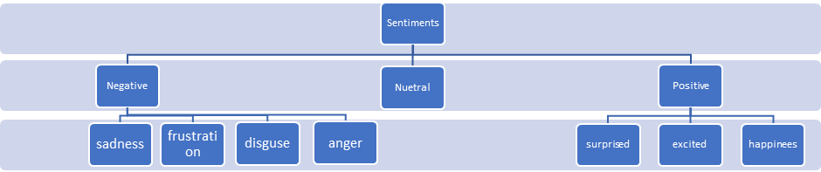
INTRODUCTION
Social Media : Great source of opinion and sentiments
Various algorithms to process data step by step
Positive, Negative and neutral sentiment analysis
Judging sentiments just by messages may go wrong!

Slide 4
OBJECTIVE
To identify the pattern conducting ethnographic study that people use social media.
To examine the impact of social media on various political and social issues.
To explore the importance of social media in various institutions.
To determine the attitude of the person posting the message.

Slide 5
SCOPE
Availability and popularity of opinion-rich resources.
Enabling opinion oriented information seeking systems.
Comprehensive surveys will help in evolving sentiment mining.

Slide 6
EXISTING SYSTEMS
Mining Twitter Data
Learning Analytics
Brand Analytics
Analysis According to Posts of User

Slide 7
DESCRIPTION
Our project will perform these steps one by one :
Data Acquisition
Pre Processing of Data
Sentiment Extraction
Sentiment Analysis

Slide 8
DIAGRAMS
Use Case Diagram
Data Flow Diagram
Sequence Diagram

Slide 9
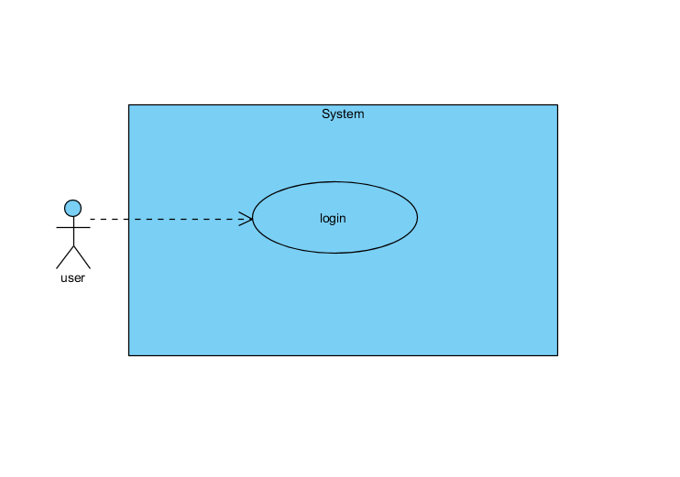
USE-CASE DIAGRAM:-

Slide 10
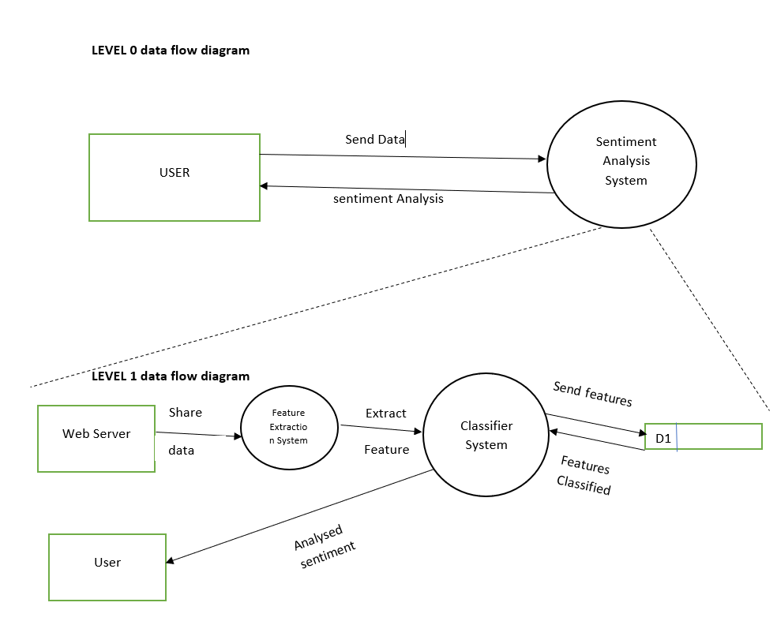
DATA FLOW DIAGRAM:-

Slide 11
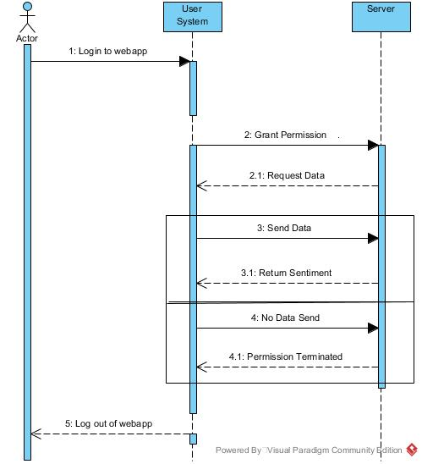
SEQUENCE DIAGRAM:-

Slide 12
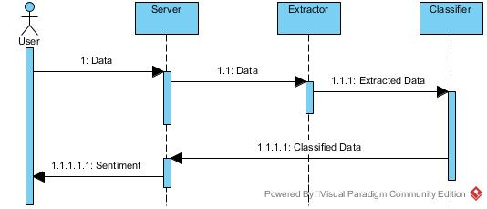

Slide 13
LIMITATIONS
Judging ones sentiments just by words is difficult, and it may be possible that the person is conveying something different by use of emoticons or stickers as under –
Sarcasm
Positive Sentiment(can be unrelated to the core issue)
Negative Sentiment(not necessarily bad)
Relative Sentiment
Neutral Sentiment and etc.

Slide 14
CONCLUSION
Evolving field with variety of use of applications.
Social media helps in making buying decisions.
Better understanding of natural language opinions.
Verification and prohibition of elements that are not right regarding social impacts.
Making analogies, continuous learning and detecting emotions – leading to highly efficient sentiment analysis.

Slide 15
REFERENCES
Research Paper :
Twitter as a corpus for sentiment analysis and opinion mining
Sentiment analysis and opinion mining : A survey
Sentiment analysis for social media
Links :
http://www.cs.unibo.it/~montesi/CBD/Articoli/SurveyOpinionMining.pdf
https://en.wikipedia.org/wiki/Sentiment_analysis

